Slide 1
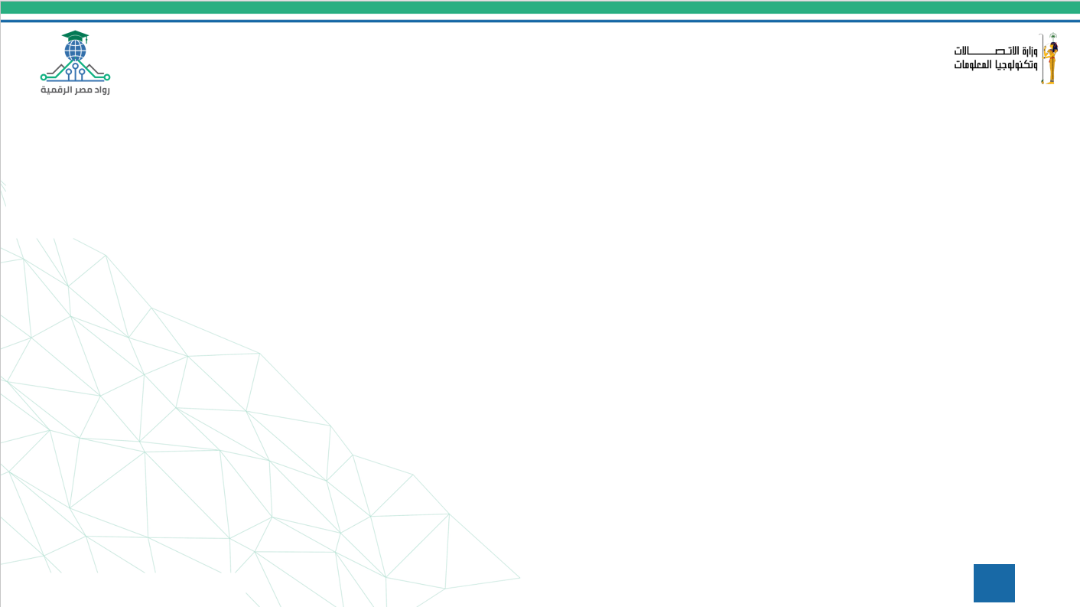


Supermarket Sales Analysis
presented by / Magda Haytham
5 / 5 /2025
1

Slide 2

Problem Statement
A consistent decline in revenue has been observed across three supermarket branches. Identifying the root causes is critical to reversing this trend and improving business performance.
Proposed Solution
Conduct a data-driven analysis of sales records across all branches, focusing on product categories, customer types, payment methods, time-based trends, and customer satisfaction. Insights will guide actionable improvements.
Unique Value Proposition
Unlike generic approaches, this project provides branch-specific insights, using advanced analytics and visualizations to uncover patterns in customer behavior, peak shopping hours, and product performance. This enables targeted strategies tailored to each location.
2

Slide 3
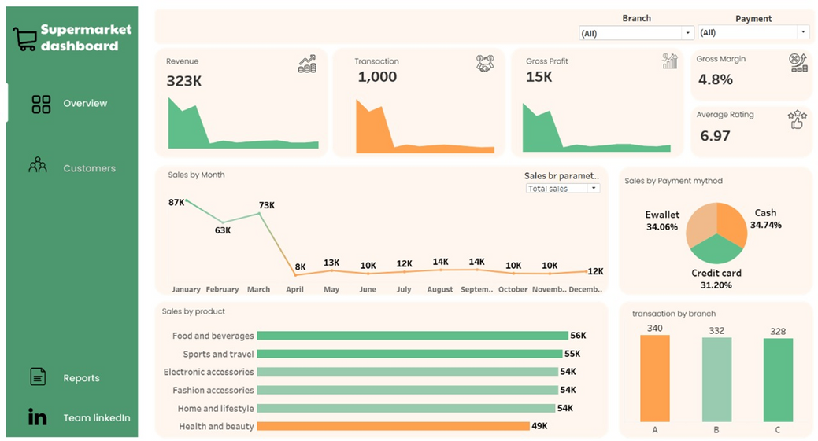
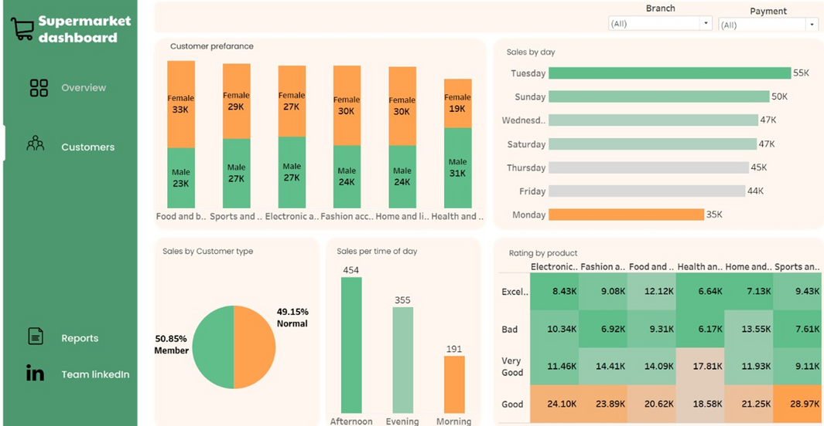
3

Slide 4
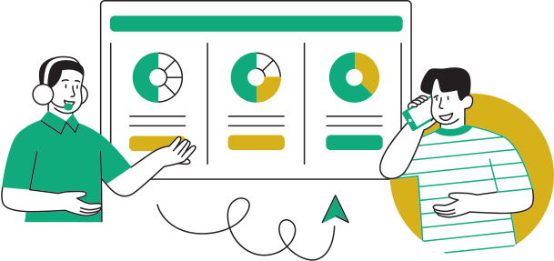

End Users (Personas)
Key Features
How Features Solve Problems
Branch Managers – Monitor branch-specific sales performance.
Sales Analysts– Analyze trends, products, and revenue drivers.
Marketing Teams – Understand customer behavior for promotions.
Executives – Review high-level summaries for decision-making.
Interactive Dashboard (branch-level revenue, product sales).
Customer Segmentation (member vs. normal customers).
Sales Trend Analysis (by date, time, branch, category).
Product Category Insights (top/bottom performing items).
Payment Method Breakdown (cash, e-wallet, credit card
  Enables quick identification of sales drops or weak categories.
  Reduces manual analysis effort with automated insights.
  Supports strategic promotions and inventory decisions.
  Provides clear visual insights for both analysts and managers
4

Slide 5


Data Structure
  Key Entities & RelationshipsTransaction-Level Data:
Each row = one sale
  Entities: Branch, Customer Type, Product Line, Payment Method, Date, Time, Total, Rating, Quantity, Gross Income
  Data FlowData Collected: From CSV file (Kaggle)
  Loaded Using: Python (Pandas) / ExcelStored Temporarily in Memory for processing and visualization
  Accessed By: Analysis tools like Python (Matplotlib/Seaborn), Power BI, or Tableau
  Techniques Used : Data Cleaning (handling missing/duplicate values)Feature Analysis (category grouping, aggregation)Visualization (branch-wise comparisons, heatmaps, trend lines)
  Data Source Dataset : Supermarket Sales
  Dataset Source : Kaggle (CSV format)Branches Covered: 3 branches (A, B, C)
  Time Period : Covers multiple months of daily transactions
  Data Characteristics Structured tabular format with labeled columns Balanced Data : Fair distribution across branches and customer types
5

Slide 6


Programming Languages + Frameworks
Programming Languages Used :
  Python – For data analysis, cleaning, and visualization.
  Excel – For initial data exploration and summary checks.
Frameworks & Tools :
  Pandas – Data manipulation and preparation
  Matplotlib & Seaborn – Visualizations and trend analysis
  Tableau – Interactive dashboards for insights
  Jupyter Notebook – Documented code and step-by-step analysis
Supporting Technologies :
  CSV file from Kaggle – Primary data source
  Google Drive – For sharing results and collaboration
  No cloud servers or databases used in current phase
6

Slide 7

Live Application + Test
: Current Application State
  The project includes an interactive dashboard created using Tableau.
  The dashboard displays branch-wise sales trends, top-selling product lines, and customer behavior insights.
  Currently deployed in a beta testing phase for internal evaluation by the project team and supervisor.
: Testing Phases
  Unit Testing: Validated each data preprocessing function in Python (e.g., total revenue calculations, branch filters).
  Integration Testing: Ensured smooth flow from data preprocessing to dashboard tools (CSV → Python → Tableau).
  User Testing: Collected feedback from teammates and supervisor on dashboard usability and design.
: Feedback
  Users appreciated the clear branch comparison visuals and sales over time trends.
  These features were successfully implemented in the final dashboard version.
7

Slide 8

Reports & Documentation
Reports & Documentation
  Final Technical Report: Includes project overview, problem statement, methodology, data analysis, and conclusions.
  User Manual: Explains how to navigate and interact with the Tableau/Power BI dashboards.
  Presentation Slides: Summarizes key results, process, and team responsibilities.
Milestones & Deadlines
  Week 1 – Data Collection & Cleaning Completed
  Week 2 – Exploratory Data Analysis (EDA) & Key Insights Identified
  Week 3 – Dashboard Development & Optimization
  Week 4 – Final Documentation & Report Submission
Final Products
  Interactive Dashboards (Tableau/Power BI): Revenue trends, product performance, and customer insights.
  Cleaned Dataset (CSV): With formatted values and missing data handled.
  Python Notebook: Includes full code for preprocessing and analysis.
  Final Report + User Guide (PDF)
8

Slide 9

Project Team Roles
Group Members & Roles
  Ahmed Hassan – Team Leader & Data Analyst
Coordinated project tasks, managed timelines, and led data analysis efforts.
  Mostafa Salem – Data Analyst & Reporting Specialist
Conducted in-depth sales analysis and contributed to writing reports and
documentation.
  Yomna Ali – Visualization & Dashboard Developer
Designed and developed interactive dashboards using Tableau and Power BI.
  Mariam Elnemrawy – Data Engineer & Documentation
Handled data formatting, integration, and wrote technical documentation.
  Magda Haytham – Cleaning Specialist & Data Analyst
Cleaned raw datasets and assisted in revenue trend and product performance analysis
Collaboration Methods
  Google Drive: Shared project files, cleaned datasets, and drafts.
  WhatsApp: Daily communication and quick decision-making.
  Weekly Meetings: Discussed progress, reviewed visuals, and resolved blockers.
  Agile Approach: Tasks were divided weekly, with updates shared in meetings.
9

Slide 10

Thank You
Contact Information
Team Leader: Ahmed Hassan
Email: ahmed.hassan@email.com
Phone: +20 111 602 9913
Questions or Feedback
We’d love to hear your thoughts and are happy to answer any questions ?
10

